Slide 1

Introduction
Contents
Intro
Boom!
Examples
Questions
Explanations
Summer Tutorial in Empiricism:
Practical Help for Experimental Novices
LEvInSoN Group - Language and Cognition Department

Slide 2
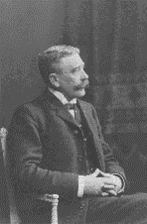
Introduction
Contents
Intro
Boom!
Examples
Questions
Explanations
Ferdinand de Saussure-
Father of Modern Linguistics
“The symbol is arbitrary”

Slide 3
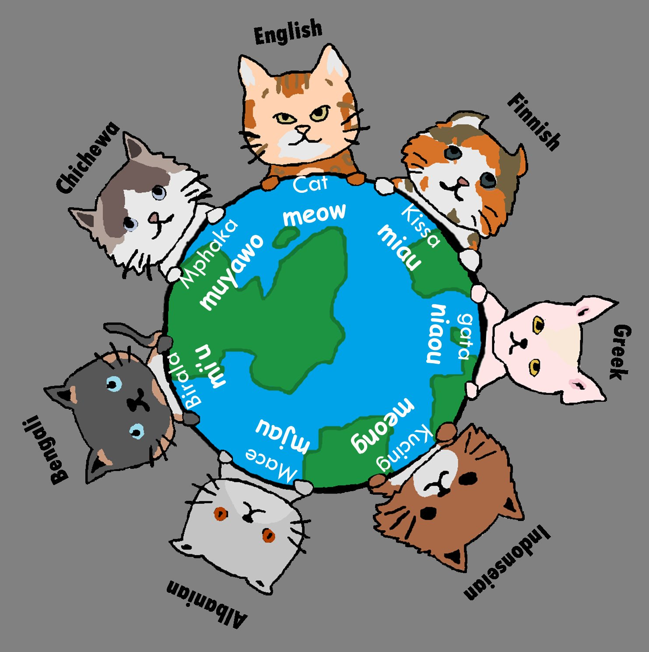
Introduction
Contents
Intro
Boom!
Examples
Questions
Explanations
Language is Arbitrary

Slide 4
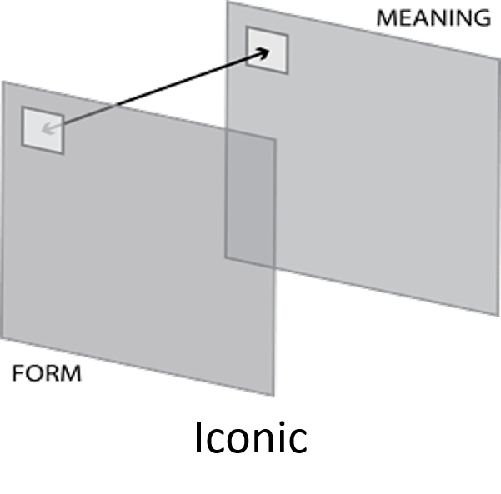
Introduction
Contents
Intro
Boom!
Examples
Questions
Explanations
Language is Not Arbitrary
Iconicity
Any connection between some feature of a word’s meaning and a feature of its representation
e.g. Onomatopoeia

Slide 5
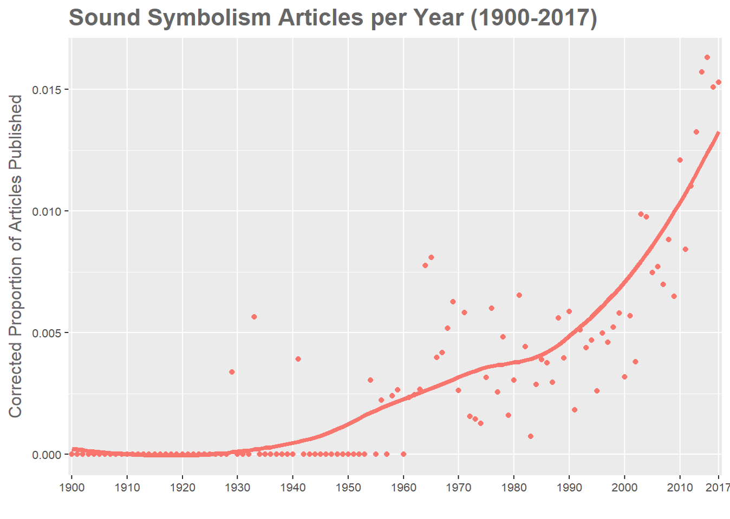
Introduction
Contents
Intro
Boom!
Examples
Questions
Explanations
The Iconicity Boom

Slide 6
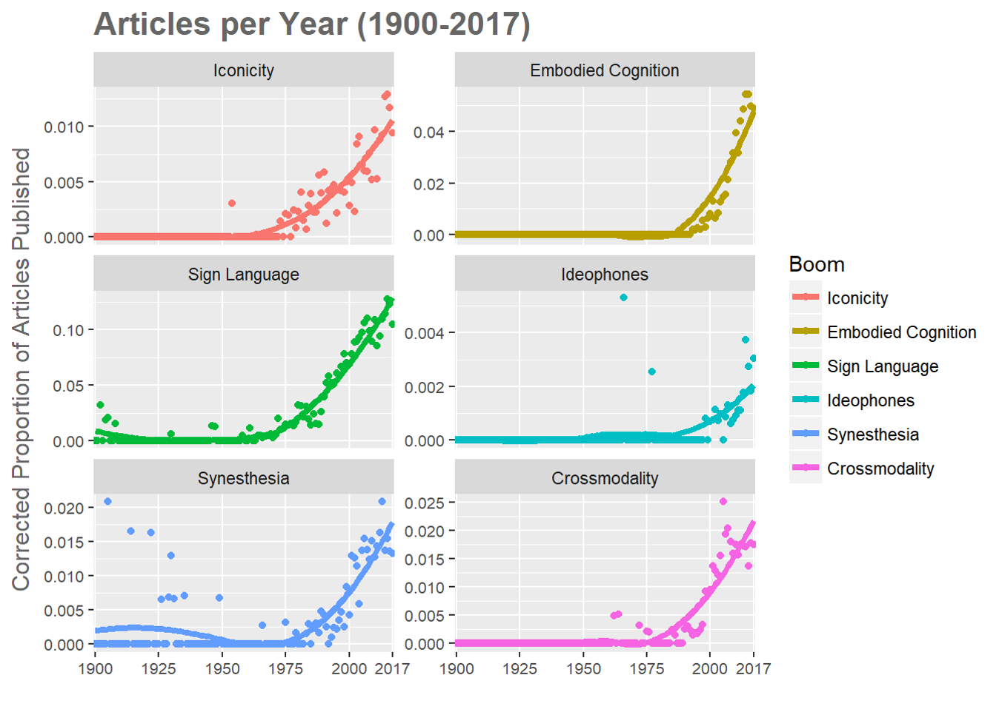
Introduction
Contents
Intro
Boom!
Examples
Questions
Explanations
The Iconicity Boom

Slide 7
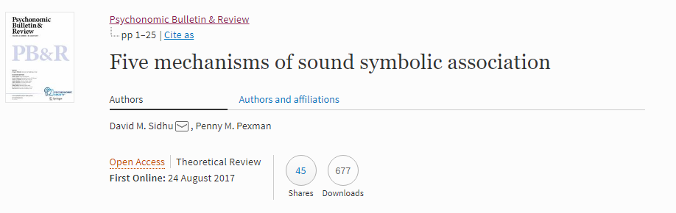
Terminology
Contents
Intro
Boom!
Examples
Questions
Explanations
The relationship between Iconicity and Crossmodality
Why is ‘mil’ smaller than ‘mal’? Why is ‘kiki’ spikier than ‘bouba’?
Assumption: Iconicity is underpinned (at least partially) by crossmodal associations (generally)

Slide 8
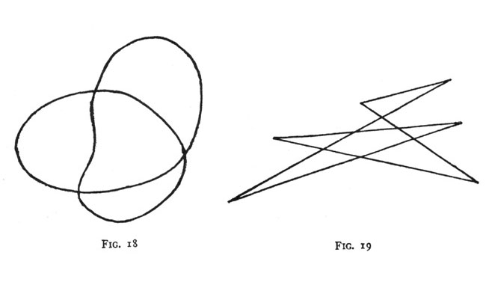

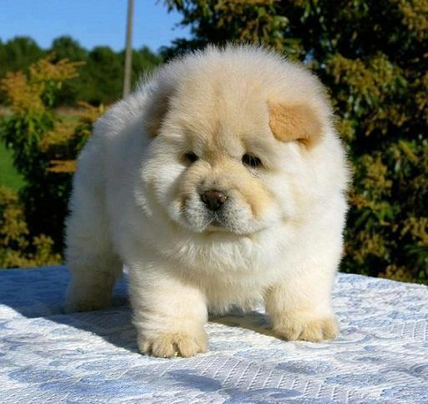
Examples
Contents
Intro
Boom!
Examples
Questions
Explanations
Iconicity
takete
maluma
mil
mal
fuwafuwa
korokoro

Slide 9
The Big Q
Contents
Intro
Boom!
Examples
Questions
Explanations
The Big Question
1- What function(s) does iconicity serve?

Slide 10
Need To Know
Contents
Intro
Boom!
Examples
Questions
Explanations
What we need to know:
1- What mechanism(s) underpin iconic biases?
2- To what degree are those biases shared between individuals?
3- To what degree are those biases shared between populations?

Slide 11
Goals
Contents
Intro
Boom!
Examples
Questions
Explanations
A sensible starting point:
1- What biases do we have?
2- How strong are they?
3- How are they related to each other?

Slide 12
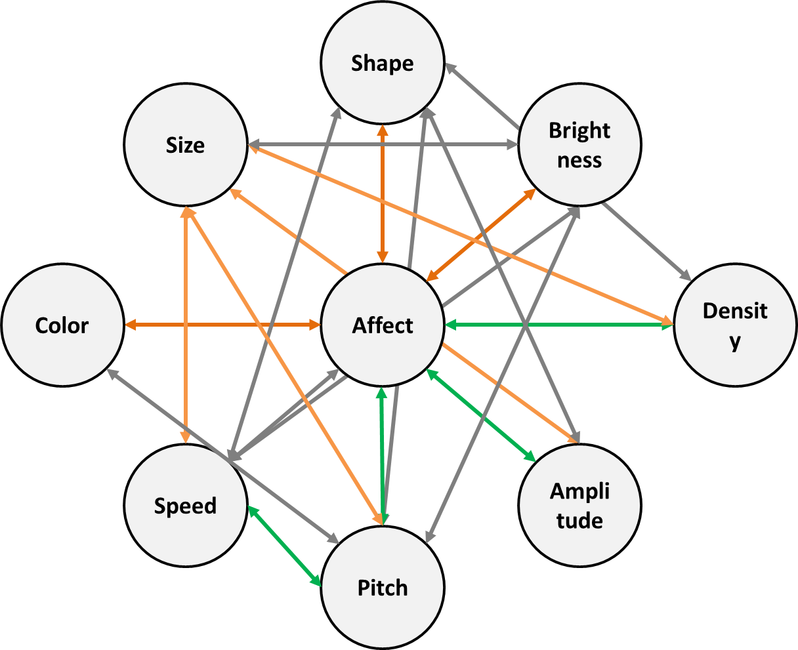
Crossmodal Biases
Contents
Intro
Boom!
Examples
Questions
Explanations
A Network of Crossmodal Biases

Slide 13
Questions?
Contents
Intro
Boom!
Examples
Questions
Explanations
Have you got any?

